Slide 1
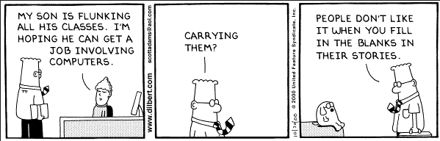

Slide 2
Range
and
For Loops
(prior to 1.3.7)

Slide 3


Slide 4


Slide 5
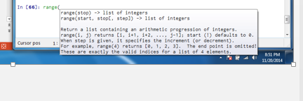

Slide 6


Slide 7


Slide 9


Slide 11


Slide 13


Slide 16
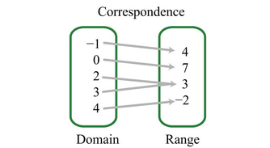
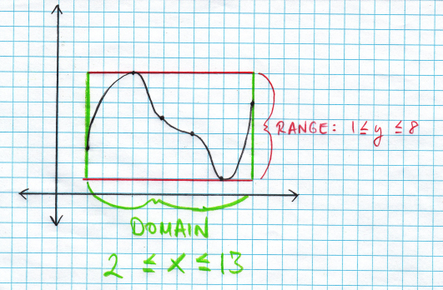

Slide 17
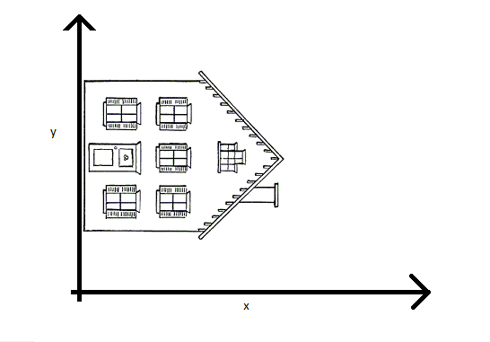

Slide 18
Home on the range!!!!

Slide 19
For Loops

Slide 20


Slide 21
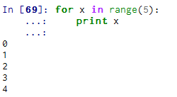
iteration

Slide 22


Slide 23
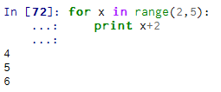
iteration

Slide 24


Slide 25
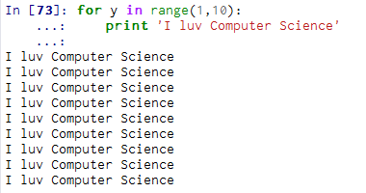
9 iterations

Slide 26


Slide 27
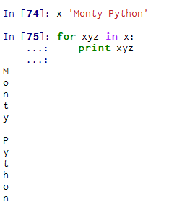
Program iterates through ‘Monty Python’ each letter at a time.

Slide 28
